Slide 1
NetworkAnalyzer
An AI Copilot for Network & Commercial Operations
Unified
Agentic AI
Human-in-loop
Network + commercial data, one assistant
Reasons over your data and self-corrects
AI proposes - people approve & act
Solution Overview
NetworkAnalyzer
Solution Overview - 1

Slide 2
Market Insight & Operator Challenges
Why operators struggle to turn data into action
Data-rich, insight-poor
Rising churn pressure
Operators hold massive network and billing data, but getting answers needs SQL, dashboards and specialists.
Subscribers leave over service quality and price - and churn is usually spotted late, after the damage is done.
Missed monetization
Siloed & slow
5G upsell, plan upgrades and retention offers go untapped without timely, targeted insight.
Network and commercial teams work apart; manual analysis takes days while decisions lag the problem.
NetworkAnalyzer
Market & Challenges - 2

Slide 3
Proposed Solution & Features
A conversational copilot over the operator's own data
Ask in plain language
Agentic reasoning
Visual insight
Natural-language questions over network + commercial data - no SQL required.
Plans multi-step queries, self-corrects wrong tables/columns, grounds answers in real rows.
Auto-generated charts, drill-down mind maps and strategy diagrams from any question.
Human-in-the-loop ops
Closed-loop campaigns
Proactive retention
The AI proposes SMS & campaigns; a person reviews, edits and approves - or originates their own.
Tracks delivery and replies, feeding results back so targeting keeps improving.
Links service issues to churn risk and surfaces high-value customers worth saving.
NetworkAnalyzer
Solution & Features - 3

Slide 4
Solution Value & Benefits
What the operator gains
Faster decisions
Proactive retention & upsell
Trustworthy answers
Answers in seconds, not days - anyone can query the data directly.
Spot at-risk high-value customers and act before they churn.
Grounded in real query results, with guards against fabricated numbers.
Safe by design
One unified view
Lower cost to insight
No action fires without human approval - with a full audit trail.
Network quality and commercial value, together at last.
Removes the analyst bottleneck between a question and its answer.
NetworkAnalyzer
Value & Benefits - 4

Slide 5
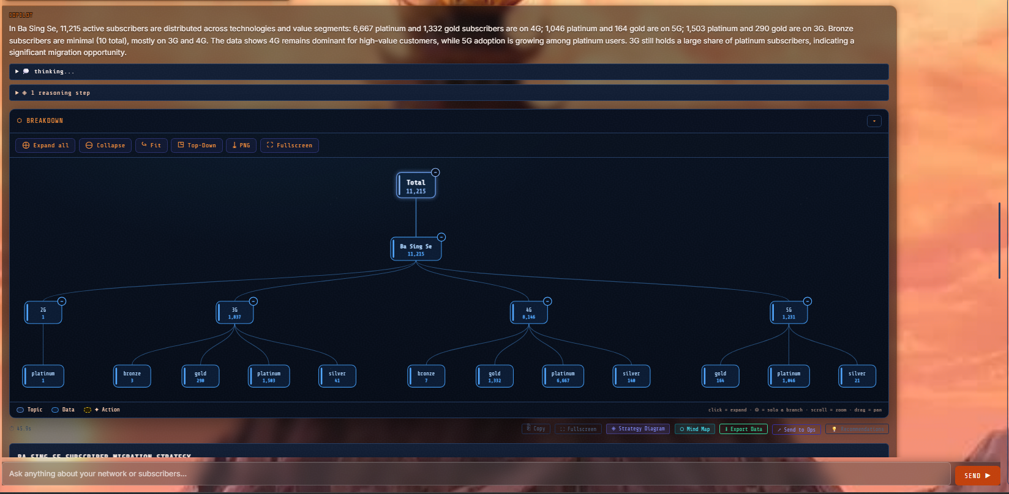
Demo & Screenshots
The solution in action
NetworkAnalyzer
Demo - 5

Slide 6
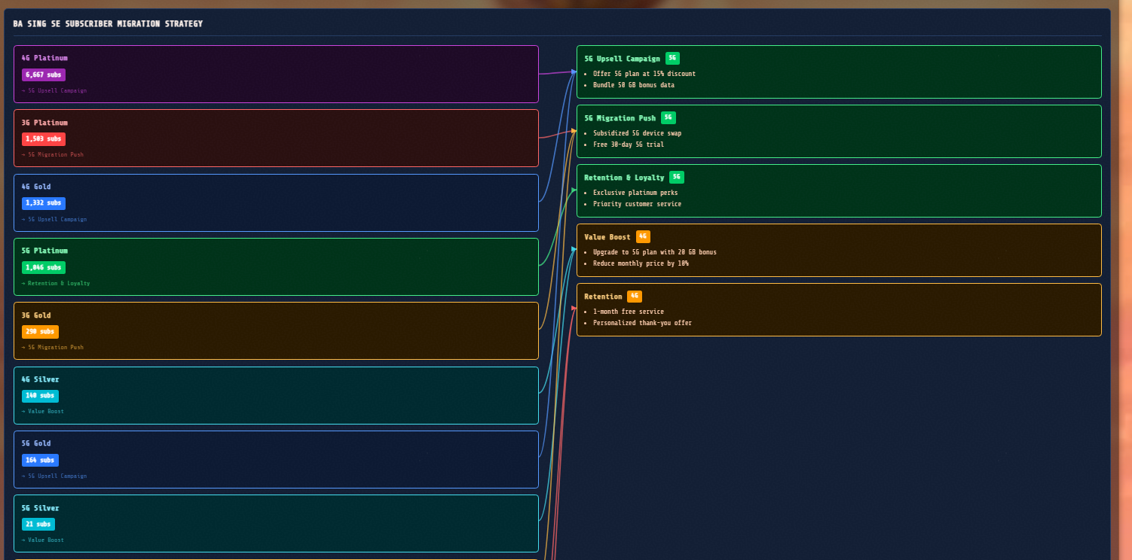
Demo & Screenshots
The solution in action
NetworkAnalyzer
Demo - 5.2

Slide 7
Areas of Improvement - What's Next
Where the solution goes from here
Multi-user & memory
Deeper churn model
Live integrations
Per-session isolation and persistent memory for team-wide use.
Fold network-experience signals directly into churn prediction.
Real SMS / CRM gateways and streaming data sources.
More autonomy
Production hardening
Broader analytics
Scheduled insights and guarded auto-actions within policy.
Scale for larger data volumes and concurrent users.
More KPIs, geospatial views and forecasting.
NetworkAnalyzer
Future Work - 6

Slide 8
Thank you
NetworkAnalyzer - turning operator data into action
NetworkAnalyzer
Thank you - 7

